Slide 1

Ray’s Rentals bicycle hire
Mark Bellingham, Maryam El-gahmi and Janet D’Souza

Slide 2

Introduction
Small business which mainly hires bikes to tourists
Currently uses a paper based record keeping system
System is inefficient
Enquiries are not being followed up
Not keeping track of frequently hired bikes
Stock levels are not organised

Slide 3
Overview
Use cases
Core use case specifications
Entity relationship diagram
Oracle script demonstration

Slide 4
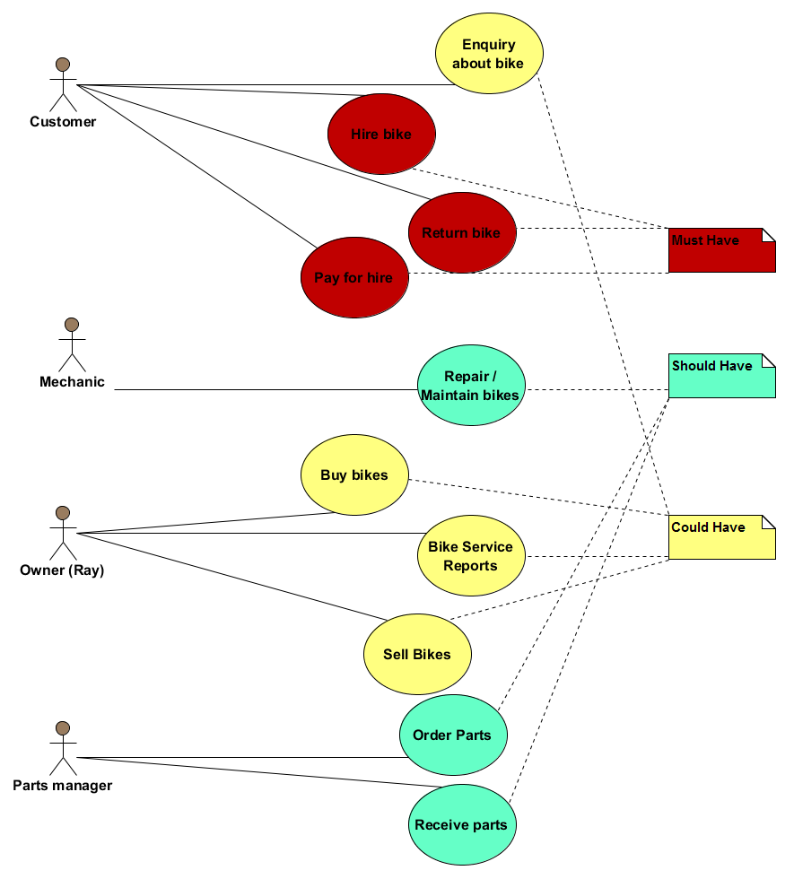
Use Cases

Slide 5
Core use case specifications
Use Case: Hire bike
Owner: customer
Pre-Conditions
Customer chooses a bike and informs a staff
Post-Conditions
Customer leaves with bike with due date and time after it has been checked out in database from a staff.
Primary Path
Customer provides staff with their contact details, chooses type of bike and hire date Staff records customers information and save it in database and checks availability. Customer hires bike Customer makes payment
Alternate Path
Customer makes reservation in advance Staff updates reservation for bike record.
Notes

Slide 6
Use Case: Bike maintenance
Owner: Ray
Pre-Conditions
Find out which bikes need servicing
Post-Conditions
Details of which bikes need servicing have been passed to the maintenance department
Primary Path
1.Check bike records 2.Create report where last service date is more than one month ago 3.List of bikes is passed to the maintenance department
Alternate Path
1.Customer complains about bike fault 2.Reception updates a list of bikes with faults 3.List of bikes is passed to the maintenance department
Notes

Slide 7
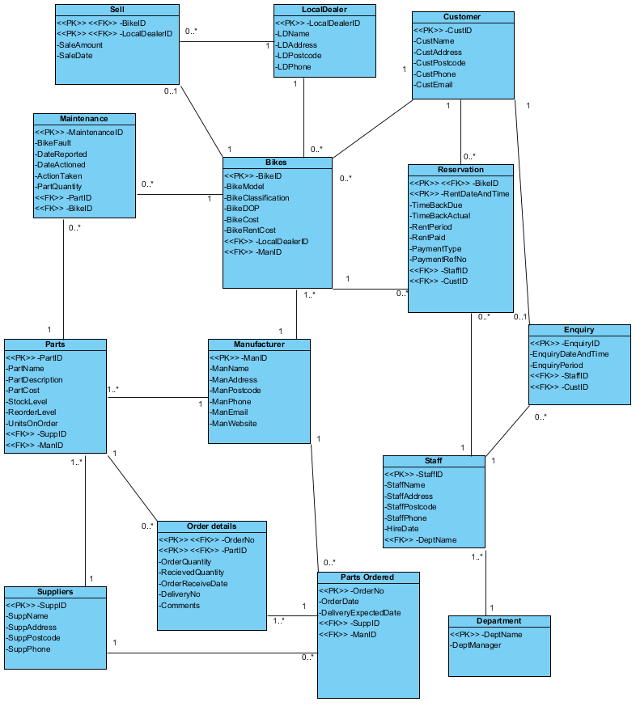
Customer
Bikes
Reservation
Entity Relationship
Diagram
Enquiry
Parts
Manufacturer
Staff
OrderDetails
Supplier
PartsOrdered

Slide 8
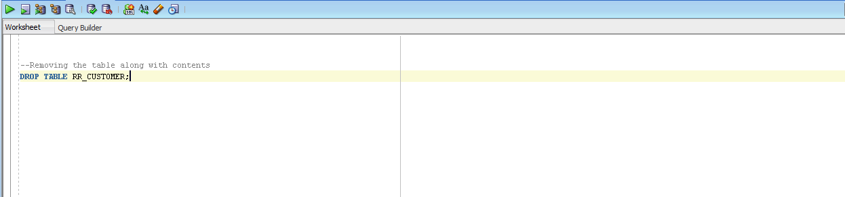
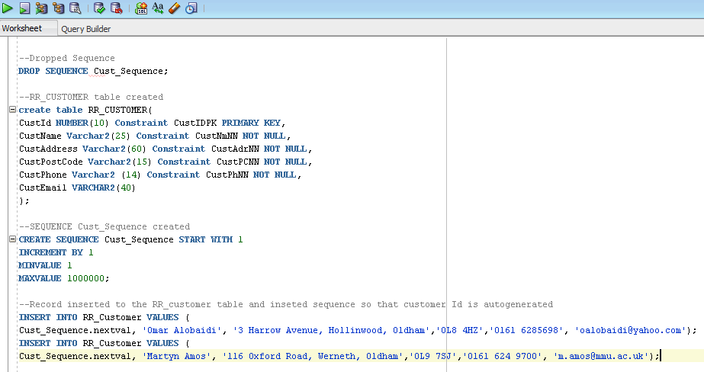
Demonstration of Oracle
Drop sequence and table, creating sequence, table and inserting record

Slide 9
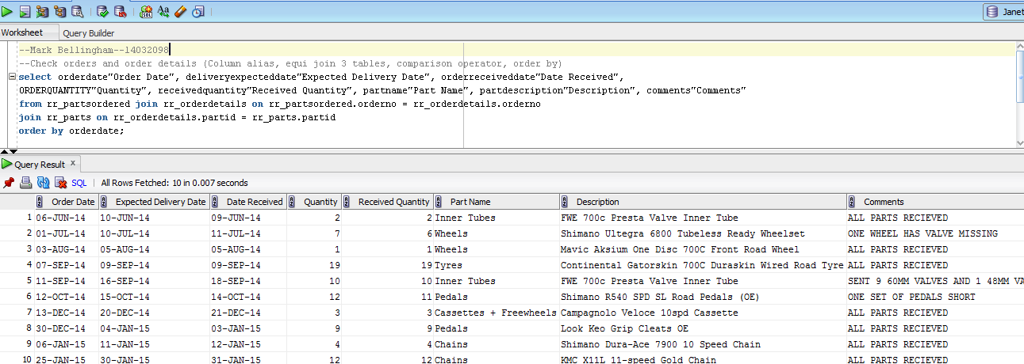
Queries

Slide 10
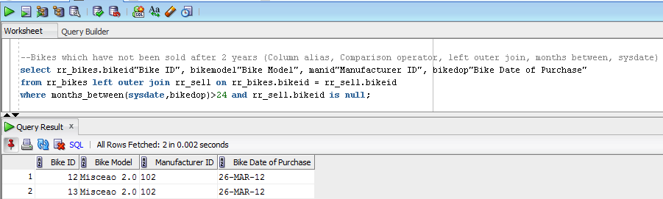

Slide 11
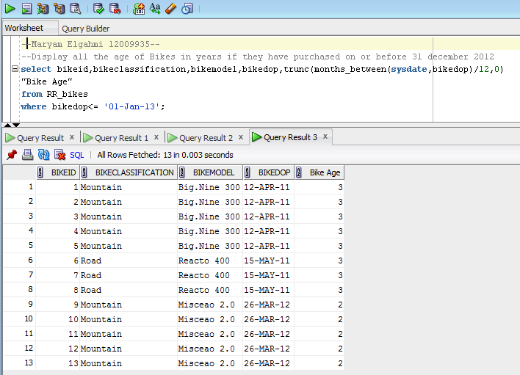

Slide 12
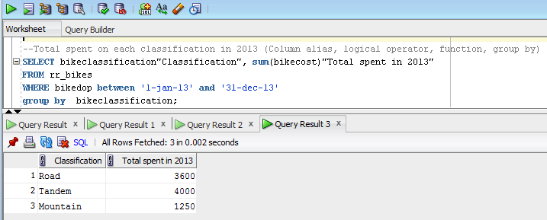

Slide 13
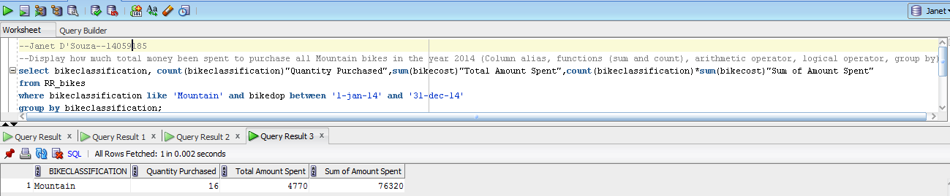

Slide 14
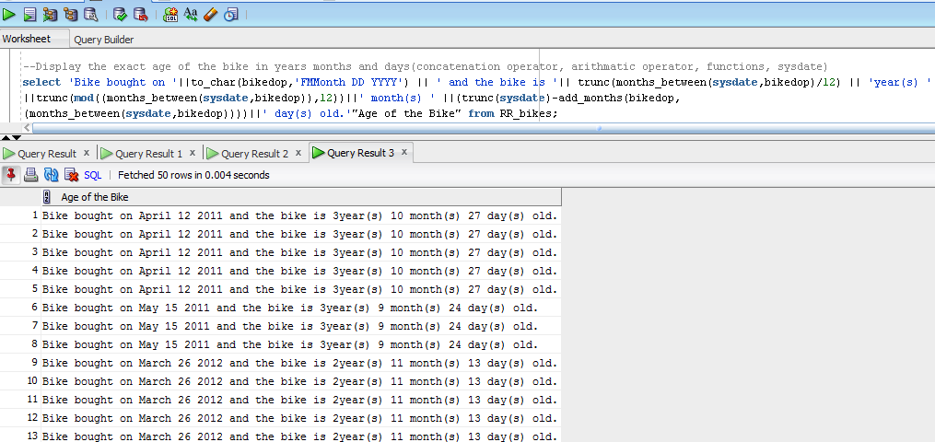

Slide 15
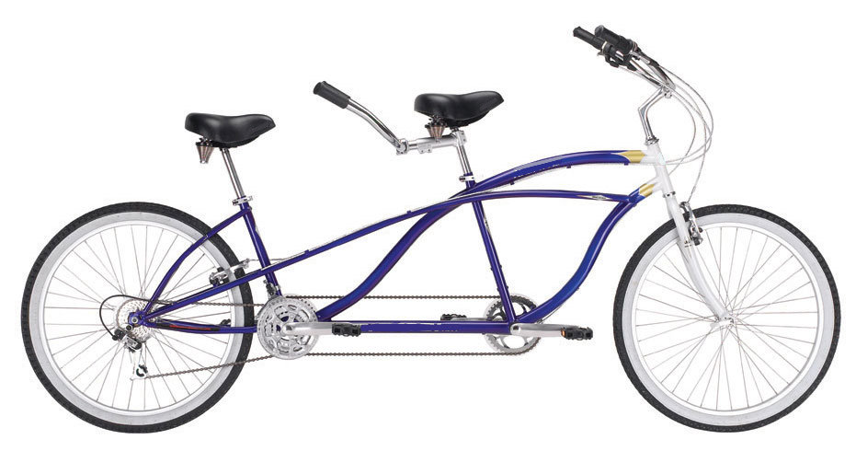
Summary
By designing and identifying Use Cases, creating use case specifications and an Entity Relationship diagram and implementing them into the database to store the business data, we have created useful reports which will help the new computerised Rays Rental System to improve the business
A centralised and computerised database makes the business more organised
No information missed out or duplicated
Easier to manage both data and operations
Can quickly search for and find errors in the data

Slide 16


